Slide 1
Cornerstone City Church Peninsula Plus Community Hoo Are Ya 29-01-2023

Slide 2
We Want To See Jesus Lifted High
CCLI Song # 1033408
© 1993 Thankyou Music
For use solely with the SongSelect® Terms of Use. All rights reserved. www.ccli.com
Note: Reproduction of this sheet music requires a CCLI Music Reproduction Licence. Please report all copies.
CCLI Licence No. 33265

Slide 3
1/4
We want to see Jesus lifted high
A banner that flies across this land
That all men may see the truth and know
He is the way to heaven

Slide 4
2/4
We want to see we want to see
We want to see Jesus lifted high
We want to see we want to see
We want to see Jesus lifted high

Slide 5
3/4
Step by step we're moving forward
Little by little we’re taking ground
Ev’ry prayer a powerful weapon
Strongholds come tumbling down
And down and down and down

Slide 6
4/4
We're gonna see we're gonna see
We're gonna see Jesus lifted high
We're gonna see we're gonna see
We're gonna see Jesus lifted high

Slide 7
Hosanna (Praise Is Rising)
CCLI Song # 4662491
Brenton Brown | Paul Baloche
© 2005, 2006 Integrity's Hosanna! Music (Admin. by Integrity Music Ltd)
Thankyou Music (Admin. by Integrity Music Ltd)
For use solely with the SongSelect® Terms of Use. All rights reserved. www.ccli.com
CCLI Licence No. 33265

Slide 8
1/6
Praise is rising
Eyes are turning to You
We turn to You
Hope is stirring
Hearts are yearning for You
We long for You

Slide 9
2/6
‘Cause when we see You
We find strength to face the day
In Your presence
All our fears are washed away
(Washed away)

Slide 10
3/6
Hosanna Hosanna
You are the God who saves us
Worthy of all our praises
Hosanna Hosanna
Come have Your way among us
We welcome You here Lord Jesus

Slide 11
4/6
Hear the sound of
Hearts returning to You
We turn to You
In Your Kingdom
Broken lives are made new
You make us new

Slide 12
5/6
‘Cause when we see You
We find strength to face the day
In Your presence
All our fears are washed away
(Washed away)

Slide 13
6/6
Hosanna Hosanna
You are the God who saves us
Worthy of all our praises
Hosanna Hosanna
Come have Your way among us
We welcome You here Lord Jesus

Slide 14
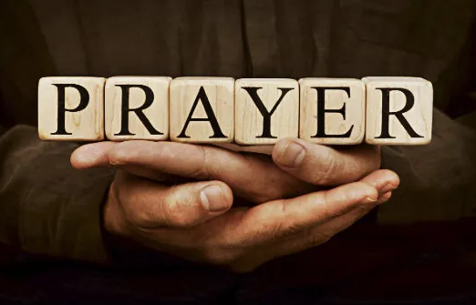

Slide 15
I Love You Lord (To My King)
Gatherhouse Music, Ryan Kennedy, Durell Comedy

Slide 16
1/6
You invite me
To sit down at Your table
Where I can taste and I can see
That You are good
and You are always faithful
To welcome me
The least of these

Slide 17
2/6
You bring beauty out of the ashes
To restore and to redeem
So I have come to pour out all my oil
All I have, this offering

Slide 18
3/6
I love You Lord, I love You
And I want to sing a sweet sweet melody
To tell You, that I love You
Let it be a sweet sweet melody
To my King

Slide 19
4/6
You inhabit the praises of Your people
So I know You're here, right now
With Your Spirit stirring all around me
Before Your glory, I bow

Slide 20
5/6
In my coming and my going
I will praise You
From the evening through the morning
I will praise You
When I rise and when I fall
I will praise You through it all
I will sing a love song to my King

Slide 21
6/6
When I'm lonely and I'm doubting
I will praise You
On the mountain when I'm shouting
I will praise You
When I rise and when I fall
I will praise You through it all
I will sing a love song to my King

Slide 22
Still
CCLI Song # 3940963
Reuben Morgan
© 2002 Hillsong Music Publishing Australia (Admin. by Hillsong Music Publishing UK)
For use solely with the SongSelect® Terms of Use. All rights reserved. www.ccli.com
CCLI Licence No. 33265

Slide 23
1/3
Hide me now
Under Your wings
Cover me
Within Your mighty hand

Slide 24
2/3
When the oceans rise
And thunders roar
I will soar with You
Above the storm
Father You are King
Over the flood
I will be still and know
You are God

Slide 25
3/3
Find rest my soul
In Christ alone
Know His power
In quietness and trust

Slide 26
Be Still And Know That I Am God
CCLI Song # 2769303
Public Domain
For use solely with the SongSelect® Terms of Use. All rights reserved. www.ccli.com
CCLI Licence No. 33265

Slide 27
1/5
Be still and know that I am God
Be still and know that I am God
Be still and know that I am God

Slide 28
2/5
I am the Lord that healeth thee
I am the Lord that healeth thee
I am the Lord that healeth thee

Slide 29
3/5
In Thee O Lord do I put my trust
In Thee O Lord do I put my trust
In Thee O Lord do I put my trust

Slide 30
4/5
I am the Lord that strengthens thee
I am the Lord that strengthens thee
I am the Lord that strengthens thee

Slide 31
5/5
I am the way the truth the life
I am the way the truth the life
I am the way the truth the life

Slide 32
Cornerstone
CCLI Song # 6158927
Edward Mote | Eric Liljero | Jonas Myrin | Reuben Morgan | William Batchelder Bradbury
© 2011 Hillsong MP Songs (Admin. by Hillsong Music Publishing UK)
Hillsong Music Publishing Australia (Admin. by Hillsong Music Publishing UK)
Hillsong Music Publishing UK
For use solely with the SongSelect® Terms of Use. All rights reserved. www.ccli.com
CCLI Licence No. 33265

Slide 33
1/4
My hope is built on nothing less
Than Jesus' blood and righteousness
I dare not trust the sweetest frame
But wholly trust in Jesus' Name

Slide 34
2/4
Christ alone cornerstone
Weak made strong in the Saviour's love
Through the storm He is Lord
Lord of all

Slide 35
3/4
When darkness seems to hide His face
I rest on His unchanging grace
In every high and stormy gale
My anchor holds within the veil
My anchor holds within the veil

Slide 36
4/4
When He shall come with trumpet sound
Oh may I then in Him be found
Dressed in His righteousness alone
Faultless stand before the throne

Slide 38


Slide 39


Slide 40


Slide 41
🇳 🇪 🇼 🇩 🇦 🇾 2⃣0⃣2⃣3⃣
Parents/Carers of 11-18 yr olds (year groups 6 - year groups 13)...
BOOKINGS ARE NOW OPEN!!
All the relevant info- including links to each of the 3 booking steps are in
the letter linked below:👇🏼👇🏼👇🏼👇🏼👇🏼👇🏼👇🏼👇🏼
Bit.ly/newday2023invitePlease note, the early bird cut off is 31st Jan.
Do get in touch if you have any questions or need to talk about finances!
202 days and counting...⏳⛺🎪⛺🎪⛺🎪⛺🎪⛺🎪Ps.
Here's a brief 60 second Newday promo for anyone who needs it...

Slide 42
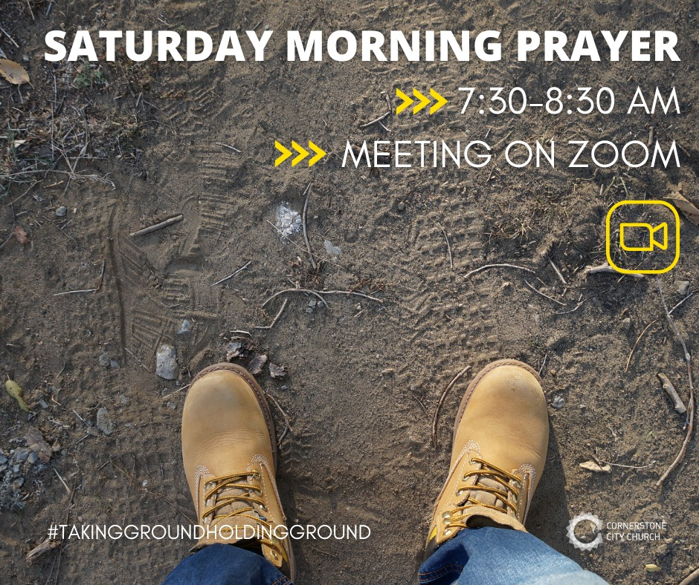

Slide 43
Just a reminder about Peninsula Churches Together Praise & Prayer night this Monday at Allhallows Church 7.30 to 8.30pm.🙏🏻🔥 It is particularly important that we gather tonight to prayer over our Villages and Communities, as the spiritual battle is heightened on this evening. Let's come together as a United Church, joining together with the all the angels, the hosts of heaven, and the Lord our God, to come against the spiritual enemy and drive them back and tear down spiritual strongholds.🔥🔥🙏🏻🙏🏻⚔️🕯️🕯️ The address is: All Saints Church, 11 Stoke Rd, Allhallows, ME3 9PF

Slide 44
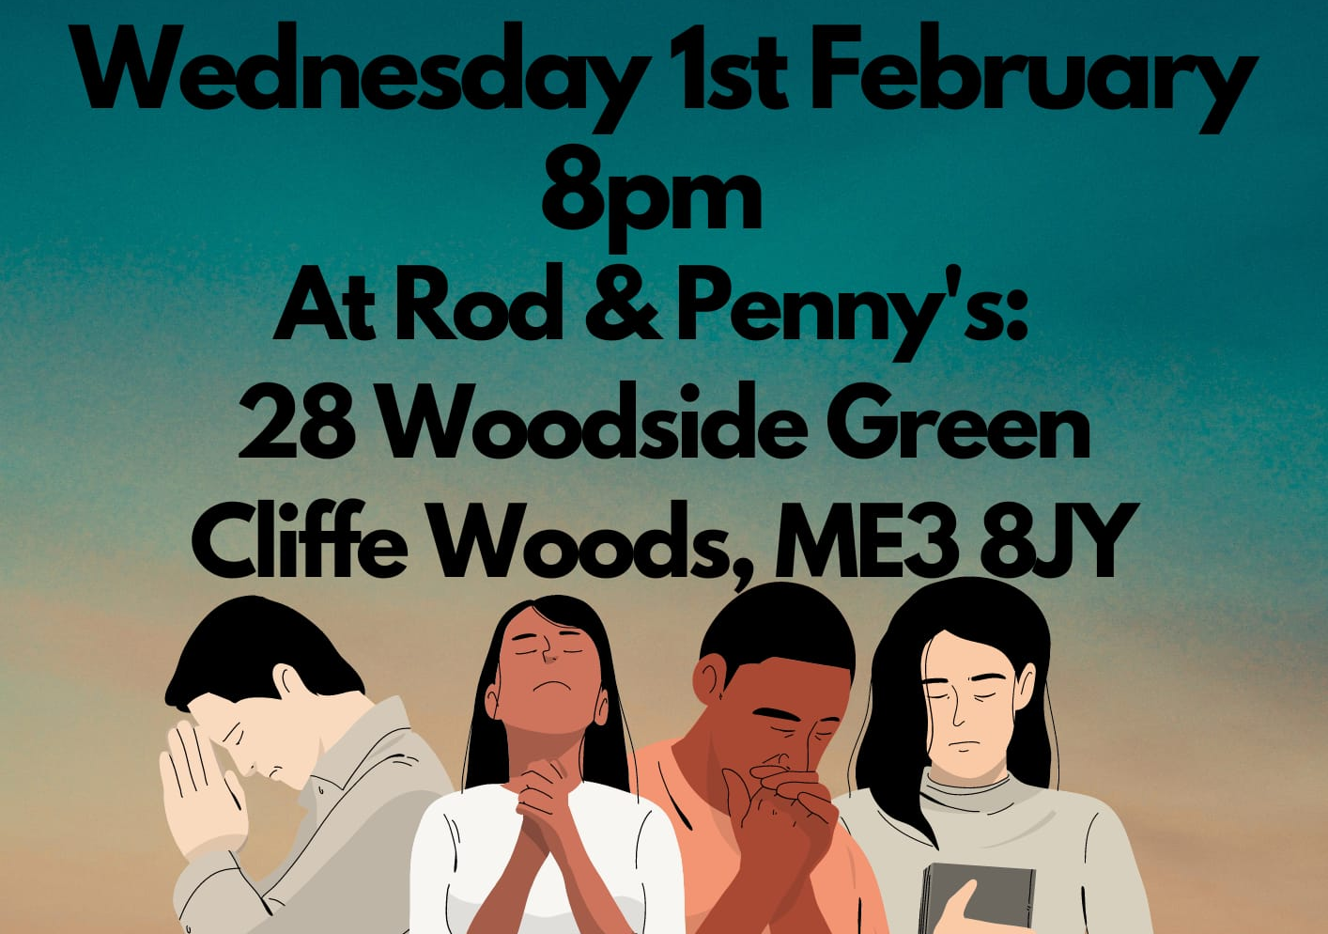

Slide 46
An Army Of Ordinary People
CCLI Song # 222241
Dave Bilbrough
© 1983 Thankyou Music (Admin. by Integrity Music Ltd)
For use solely with the SongSelect® Terms of Use. All rights reserved. www.ccli.com
CCLI Licence No. 33265

Slide 47
1/3
An army of ordinary people
A kingdom where love is the key
A city a light to the nations
Heirs to the promise are we
A people whose life is in Jesus
A nation together we stand
Only through grace are we worthy
Inheritors of the land

Slide 48
2/3
An army of ordinary people
A kingdom where love is the key
A city a light to the nations
Heirs to the promise are we
A people whose life is in Jesus
A nation together we stand
Only through grace are we worthy
Inheritors of the land

Slide 49
3/3
A people without recognition
But with Him a destiny sealed
Called to a heavenly vision
His purpose shall be fulfilled
Come let us stand strong together
Abandon ourselves to the King
His love shall be ours forever
This vict'ry song we shall sing

Slide 50
God of This City
CCLI Song # 5037070
Aaron Boyd | Andrew McCann | Ian Jordan | Peter Comfort | Peter Kernoghan | Richard Bleakley
© 2006 Thankyou Music (Admin. by Integrity Music Ltd)
For use solely with the SongSelect® Terms of Use. All rights reserved. www.ccli.com
CCLI Licence No. 33265

Slide 51
1/2
You're the God of this city
You're the King of these people
You're the Lord of this nation
You are
You're the light in this darkness
You're the hope to the hopeless
You're the peace to the restless
You are

Slide 52
2/2
There is no one like our God
There is no one like You God
Greater things have yet to come
And greater things have still to be done
In this city
Greater things have yet to come
And greater things have still to be done here

